Slide 1
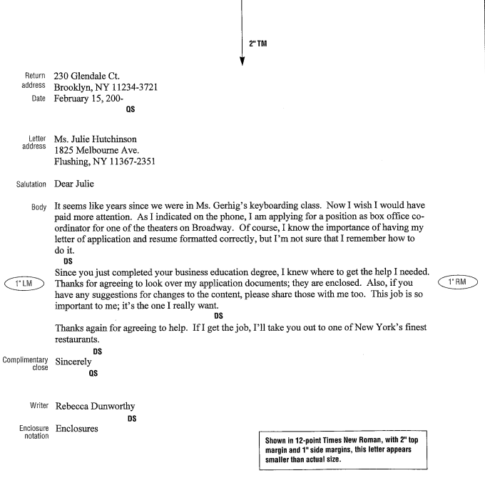
Learn to Format
Personal Business Letters

Slide 2
Letter Margins
Top Margin: 2“ (or start on line 13)
Side Margins: 1”
Bottom Margin: 1
Most letters are centered vertically on the page.

Slide 3
Basic Parts of a Personal-Business Letter
Return address – The address of the person the letter is from.
  Use proper letter format.
  Remember, there are 3 spaces before the zip code.
Date – Key the month, day and year on the line below the city, state, and ZIP code.
Letter address – To whom the letter is being sent.
  Type the first line of the letter (delivery) address a QS (4 returns) below the date. A personal title (Miss, Mr., Mrs., Ms.) or professional title (Dr., Lt., Senator) is keyed before the receiver’s name.
Salutation – Greeting
  Typed a DS (2 enters) below the letter address.
Body of the Letter – It is typed a DS below the salutation.
  They should be SS within paragraphs and DS between them.
Complimentary close – typed a DS below the last line of the body of the letter.
Name of the writer – Person sending the letter.
  Typed a QS below the complimentary close.

Slide 4
Special Parts of Letters
Reference Initials – References initials should be added if someone is typing the letter for someone else.
  Type the typists initials in lowercase letters at the left margin, a DS below the writer’s name.
Attachment/Enclosure
  Attachment Notation – If another document is attached to a letter, the word Attachment is typed at the left margin, a DS below the reference initials.
  Enclosure Notation – If the additional document is not attached, the word Enclosure is used.
  If reference initials are not used, the word Attachment or Enclosure are typed a DS below the writer’s name.

Slide 5
All Letters MUST be mailable – Error Free
ALWAYS PROOFREAD CAREFULLY!
Common Greetings
  Mr.
  Mrs.
  Ms.
  Miss
  Dr.

Slide 6
Sample
Personal
Business
Letter

Slide 7
Personal Business Letters Project
Save as pletters
Insert a header at the top of the page
Font: Courier New, size 10

Slide 8
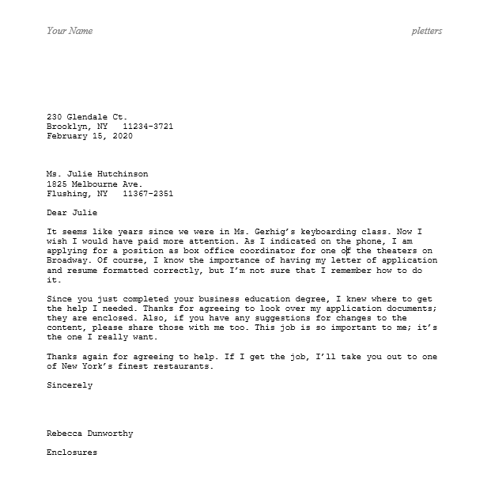
Personal
Business
Letter 1

Slide 9
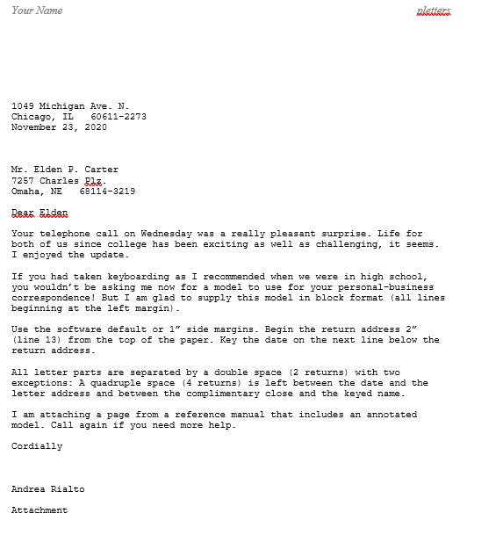
Personal
Business
Letter 2

Slide 10
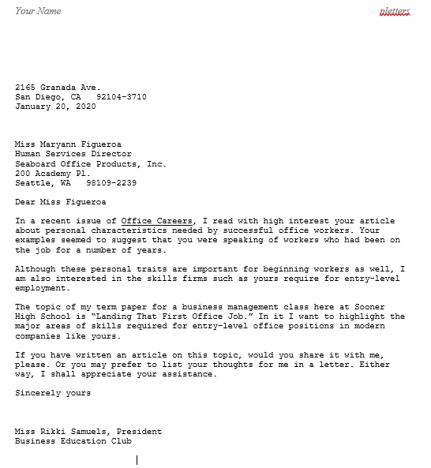
Personal
Business
Letter 3

Slide 11
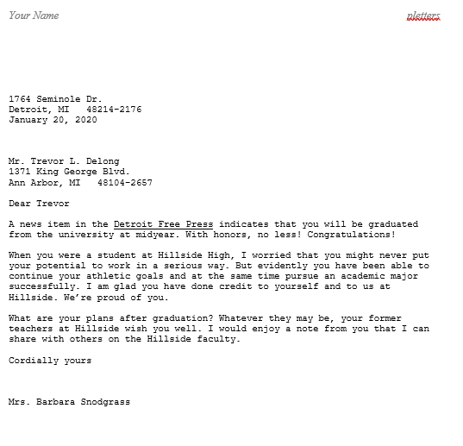
Personal
Business
Letter 4

Slide 12
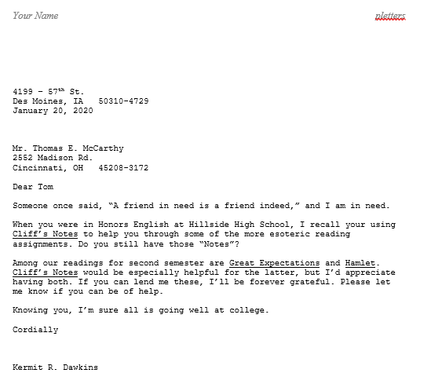
Personal
Business
Letter 5

